Slide 1
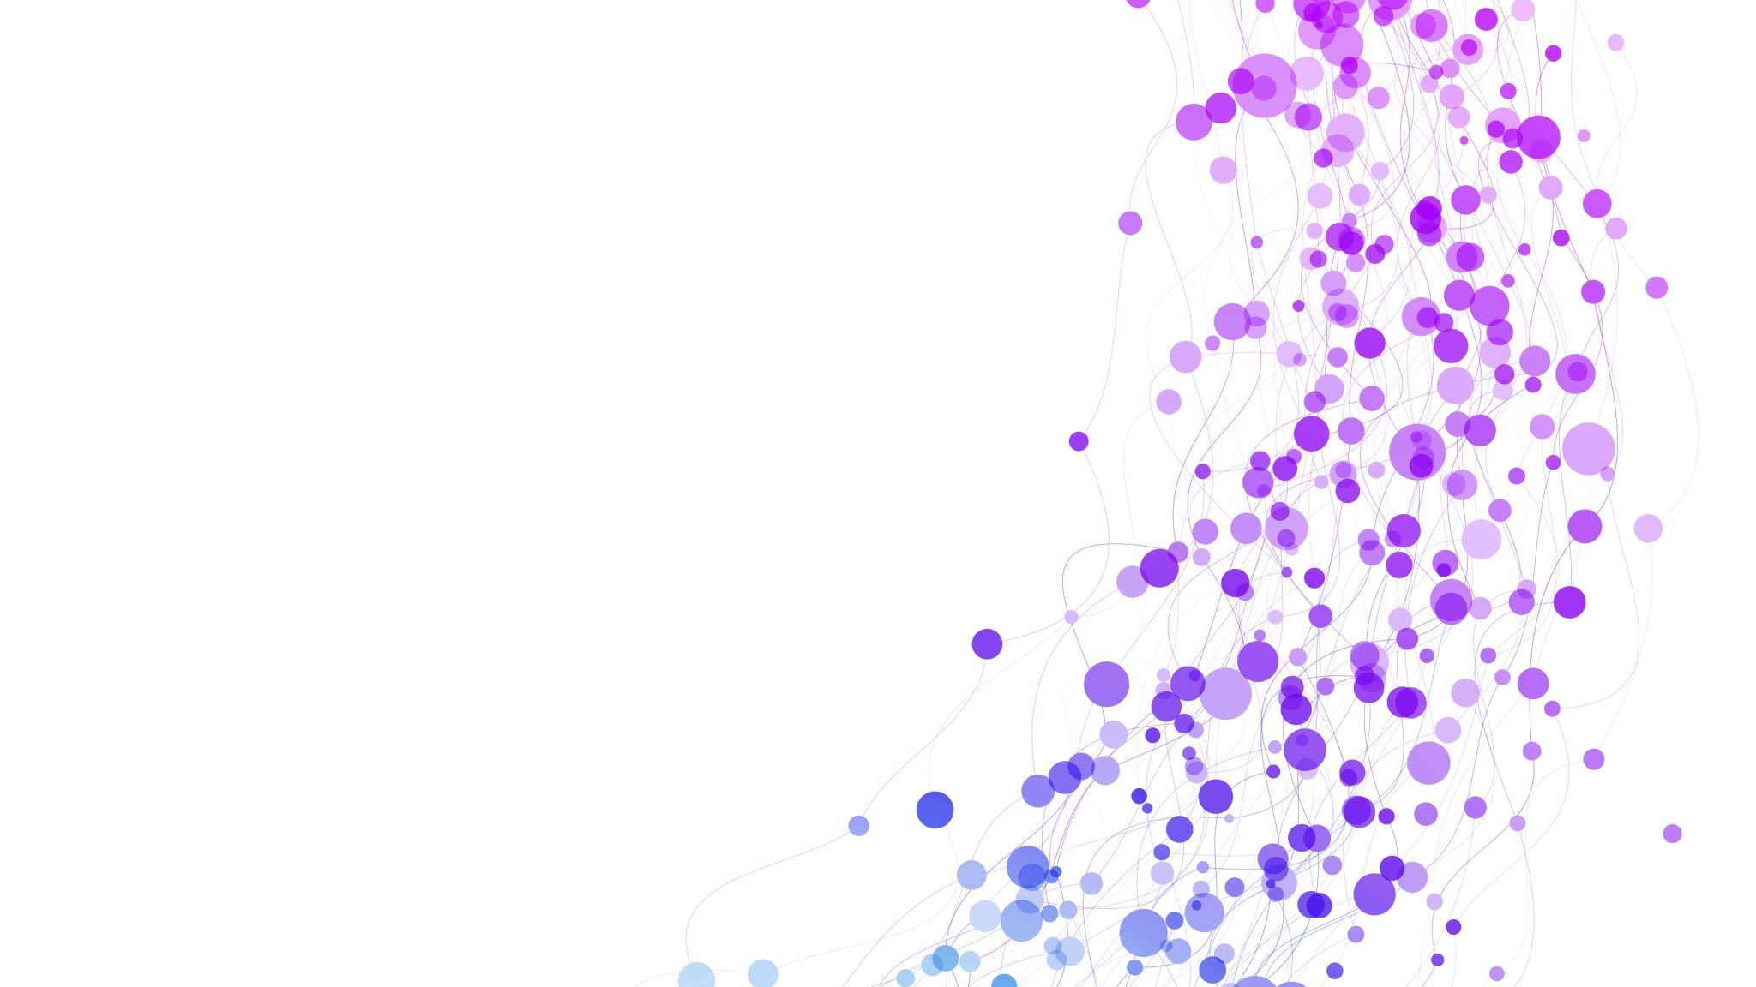
Spatiotemporal Non-Uniformity-Aware Online Task Scheduling in Collaborative Edge Computing for IIoT
Team: Thing Different - 02
Authors: Yang Li, Xing Zhang, Yukun Sun, Wenbo Wang, Bo Lei
CB.SC.U4CSE23105 - Amrith
CB.SC.U4CSE23142 - S Ajeth
CB.SC.U4CSE23145 - Sarvesha
CB.SC.U4CSE23157 - Varun

Slide 2
Motivation
The Challenge with Cloud Computing
High Latency: For critical industrial applications, sending data to a distant cloud server introduces unpredictable delays that are unacceptable for real-time control and monitoring.
Privacy Concerns: Sensitive factory data and intellectual property are often legally required to remain within a private, local network, which traditional cloud computing cannot guarantee.
The Rise of Mobile Edge Computing (MEC)
Proximity: MEC places computing resources close to the data source, directly addressing the latency problem.
Resource Limitations: However, individual edge servers have limited capacity compared to the vast resources of the cloud. This leads to them becoming easily overloaded as the number of IIoT devices and data streams increases.
The Problem this Research Solves
Collaborative Need: The limitations of individual edge servers necessitate a collaborative edge computing framework, where multiple edge nodes work together to share the workload.
Spatiotemporal Non-Uniformity: The main problem is that task requests from different factories are unevenly distributed over both time and location. This unpredictable nature makes efficient scheduling incredibly complex.
The Core Goal: The research is motivated by the need to create a smart, real-time task scheduling system that can handle this dynamic unpredictability while simultaneously minimizing long-term delays and adhering to a strict long-term operational cost budget.

Slide 3

Core Problem Statement and Unique Challenges
The Core Problem: The central objective is to develop a task scheduling framework that minimizes long-term average task processing delay while strictly adhering to a long-term operational cost budget.
Unique IIoT Challenges:
1. Horizontal Collaboration: Due to privacy-sensitive data, IIoT applications often restrict task processing to a local, trusted network. This forces horizontal collaboration between edge nodes in different factories, rather than vertical offloading to the cloud.
2. Spatiotemporal Non-Uniformity: Service requests from IIoT devices are not only unevenly distributed geographically (spatial non-uniformity) but also fluctuate significantly over time (temporal non-uniformity).
3. Dynamic System State: The system is constantly in a state of flux. This makes it impossible to rely on traditional methods that require prior knowledge of future request distributions or network states.
4. NP-Hard Nature: The combination of these factors creates a problem that is computationally infeasible to solve for a globally optimal solution in polynomial time, establishing it as an NP-hard problem. This directly justifies the need for efficient heuristic algorithms.

Slide 4
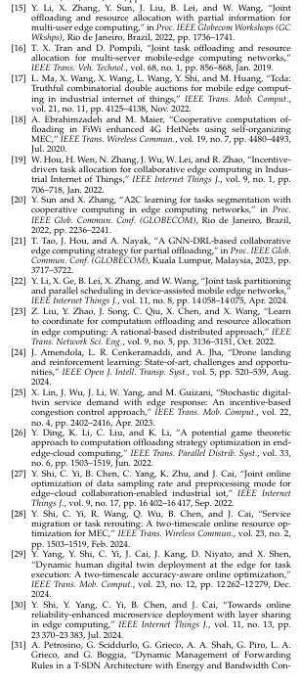
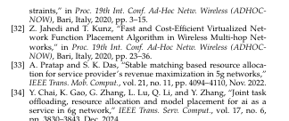
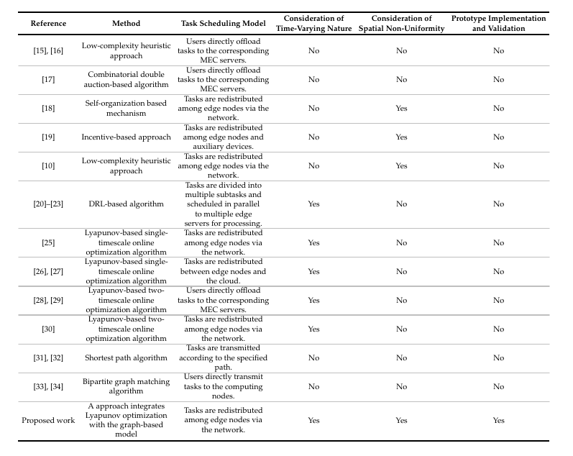
State of Art Literature Survey

Slide 5

State of the Art Literature Survey Contd.
Single-Node Focus: Many existing studies assume end devices can offload tasks directly to all edge nodes, neglecting the reality that tasks must be redistributed via the network between collaborating edge nodes.
Short-Term Performance: Research on collaborative offloading often focuses on short-term gains, ignoring the long-term effects of time-varying request distributions on overall costs and performance.
DRL Drawbacks: While Deep Reinforcement Learning (DRL) is a popular approach, it suffers from significant issues for critical IIoT applications. Its training process is prone to instability and oscillations, and as a "black box" model, it lacks strict performance guarantees.
Lyapunov Limitations: Existing Lyapunov-based methods primarily focus on either spatial or temporal respectively and cannot be directly applied to problems with the coupled spatial and temporal dimensions present in IIoT.
Computational Cost: Other approaches, particularly those using graph models, often suffer from high computational costs that make them impractical for large-scale, real-time IIoT environments.
Lack of Real-World Validation: A critical gap is the absence of demonstrated superior performance in real engineering applications, as many solutions are difficult to implement in practice.

Slide 6
Contribution of this paper
A Novel Integrated Framework:
Lyapunov Optimization + Graph Models: The paper's primary contribution is a unique, integrated framework that combines Lyapunov optimization (to manage long-term costs) with a graph-based model (to handle spatial non-uniformity). This is the first approach to effectively address both the time-varying and geographically distributed nature of the IIoT task scheduling problem.
Enhanced Scalability and Efficiency:
Heuristic-Based Hierarchical Optimization: To tackle the computationally complex (NP-hard) nature of the problem, the paper introduces a two-stage heuristic approach. This breaks the problem into a simpler category assignment and a task scheduling sub-problem, significantly improving efficiency.
Imitation Learning for Acceleration: For large-scale systems, an imitation learning-based scheme is introduced. This trains a neural network to mimic the heuristic's decisions, providing a significant reduction in runtime and making the solution practical for very large networks.

Slide 7
Architecture Overview
1. User Plane: IIoT Devices
This plane consists of IIoT devices (e.g., sensors, robots, smart machinery) distributed across various factories.
These devices generate real-time data and send requests for services to the closest Access Point (AP) located within their own factory.
2. Edge Computing Plane: APs, Edge Servers, and Inter-factory Network
Each factory is equipped with an Access Point (AP) and a powerful Edge Server (ES). The AP receives the service requests from the IIoT devices.
The Edge Servers are responsible for processing these requests. Due to privacy concerns, the initial processing is confined to the factory's local ES.
The factories are interconnected via a network, enabling horizontal collaboration. This allows an AP to forward tasks to other ESs in different factories if its local ES is overloaded or if another ES is better suited to handle the task.
3. Central Controller: The Brain
This is the central entity that oversees the entire system. It is responsible for making all the high-level task scheduling decisions.
It constantly senses the system state, including the number of new requests at each AP and the available resources at each ES.
Based on its analysis, it dynamically adjusts the task scheduling strategies and dispatches these policies to the APs. The APs then use these policies to decide whether to process tasks locally or redistribute them to other collaborating edge nodes.
The Central Controller effectively decouples slow-changing resource allocation (e.g., how much CPU to give a service) from fast-changing task scheduling, which is a key design choice for a stable and efficient system.

Slide 8
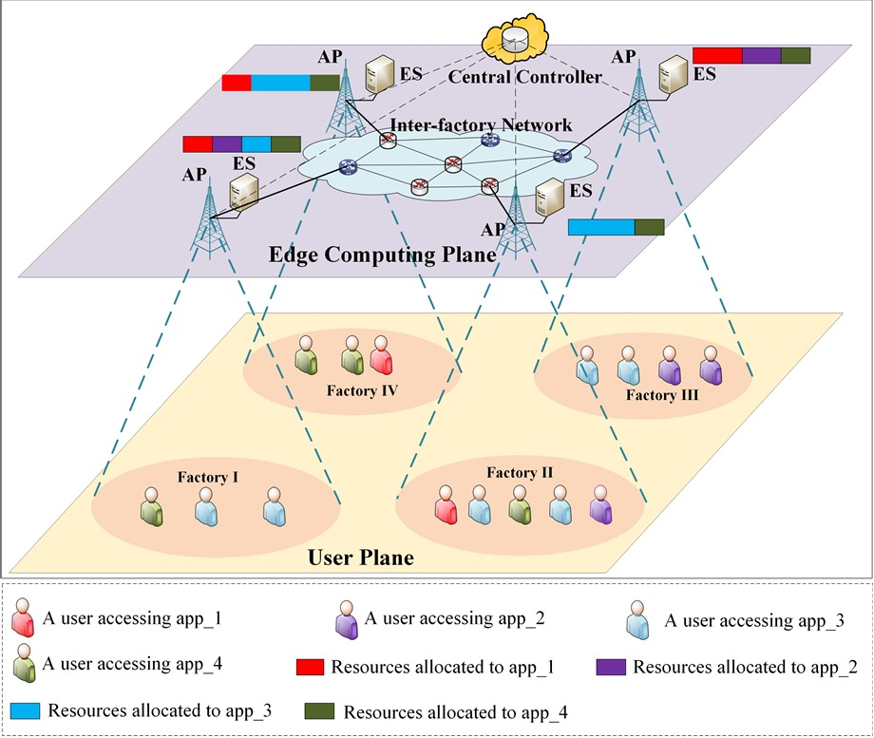
Architecture Diagram

Slide 9
The Role of Lyapunov Optimization:
General Use: It's a mathematical tool for solving stochastic optimization problems in unpredictable systems. It helps satisfy long-term goals (like a budget) while making real-time, short-term decisions (like minimizing delay).
Specific Use: In this research, it is used to manage the long-term operational cost budget while simultaneously minimizing the long-term average task processing delay

Slide 10
The Role of Lyapunov Optimization Contd.
How it's Used: Lyapunov optimization works by transforming a long-term problem into a series of real-time, single-slot problems. It does this by creating a "virtual queue" that tracks the violation of the long-term cost constraint. The algorithm's job is to make decisions in each time slot that keep this virtual queue stable.
Why it's Used: It is a perfect fit for this problem because the IIoT environment is highly dynamic and stochastic. Traditional methods that require a perfect forecast of future events are impractical. Lyapunov optimization allows the system to be proactive and adaptive, making decisions based on the current system state, a crucial capability for real-time industrial applications.
When it's Used: The Lyapunov optimization algorithm is invoked at the beginning of each discrete time slot. In each slot, it performs the following steps:
It observes the current system state (e.g., new requests, virtual queue backlog).
It solves the real-time sub-problem to find the best scheduling decision for that specific time slot.
It updates the virtual queue based on the cost of the decision made.
It proceeds to the next time slot, repeating the process.

Slide 11
Heuristic-Based Hierarchical Optimization
General Use
What it is: A strategy that breaks down a complex, difficult problem into smaller, more manageable sub-problems to find a quick, effective solution.
Why it's used: It's a pragmatic way to solve NP-hard problems, which are too slow to solve perfectly.
Specific Use in this Research
How it's used here: A two-step process to solve the NP-hard task scheduling problem:
Step 1: A discrete particle swarm algorithm (PSO) classifies factories as a source, sink, or isolated node. This dramatically simplifies the problem.
Step 2: A harmony search (HS) algorithm then determines the specific number of tasks to be forwarded between the classified nodes.
The result: This approach finds an efficient, near-optimal scheduling decision in real time, making the problem solvable for practical IIoT deployments.

Slide 12
Low-Complexity Acceleration with Imitation Learning
General Use
What it is: A machine learning strategy where an agent learns to perform a task by mimicking an expert's behavior, rather than learning through trial and error.
Why it's used: It is highly effective for reducing computational complexity and improving scalability, especially in systems where real-time decisions are critical and a slower, more complex "expert" algorithm already exists.
Specific Use in this Research
How it's used here: The project's more complex Heuristic-Based Hierarchical (HH) algorithm acts as the "expert." An Imitation Learning (IL) model, built with a Graph Neural Network (GNN), is trained to mimic the HH algorithm's high-level category assignment decisions.
The result: This allows the system to make decisions with a significant reduction in runtime, making the solution practical and scalable for large-scale IIoT deployments where low-latency responsiveness is a priority.

Slide 13
Implementation strategy
Codebase: GitHub repository provided in the paper
Programming Language: Python
Core Libraries: PyTorch
Simulation Environment: PyTorch
Code Setup: Clone the repository and install all required Python libraries.
Expert Training: Run the slower Heuristic-Based Hierarchical (HH) algorithm to generate a dataset of optimal decisions.
Model Training: Use this dataset to train the fast Imitation Learning (IL) model (a GNN) to mimic the HH algorithm's decisions.
Scenario Simulation: We'll test the trained model against various scenarios, including different values for the V parameter and varying numbers of factories.
Comparative Analysis: We will compare our results against benchmark algorithms to validate the paper's claims of superior performance and scalability.
Performance Metrics:
Average Task Processing Delay: Measures the quality of service by calculating the average time from task arrival to completion.
Long-Term Average Task Processing Cost: Measures the total operational cost over time to ensure adherence to the budget.
Computational Running Time: Evaluates the scalability and real-time feasibility of the algorithms as the network size changes.
Virtual Queue Backlog: Used to demonstrate the algorithm's stability and its ability to effectively control the long-term cost constraint.
Weighted Sum of Normalized Delay and Overrun Cost: A combined metric that shows the tunable balance between performance and cost.

Slide 14

Team Roles and Contributions
Amrith: Implementation Optimization Algorithm from GitHub
Varun: Implementation of Heuristic based Search Algorithm from GitHub
Ajeth: Simulator Setup
Sarvesha: Experiment Design and Analysis

